Slide 1
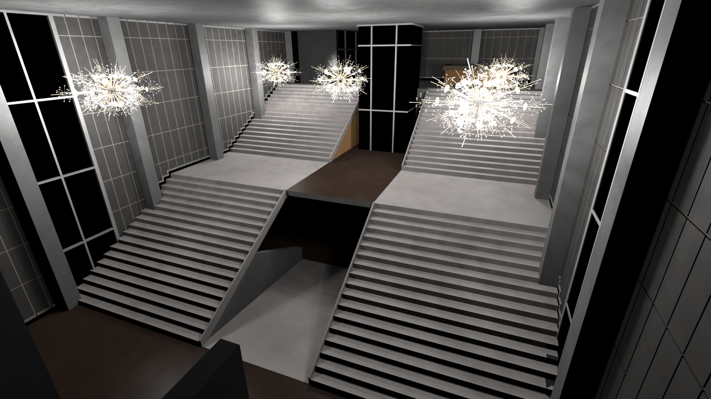
Complex Luminaire Rendering
Edgar Velázquez-Armendáriz | Zhao Dong | Bruce Walter | Donald P. Greenberg
Program of Computer Graphics, Cornell University
February 25th 2013

Slide 2
Motivation
Limited luminaire models used in C.G.
Industry uses 25 years old models
Better representations exist but rarely used
Real world lighting fixtures are complex
Lighting design common practice in Architecture
We want to use such rich luminaires in C.G.

Slide 3
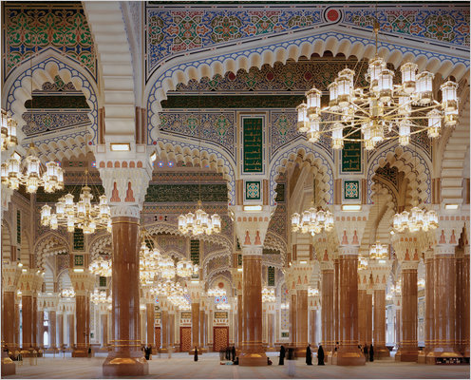
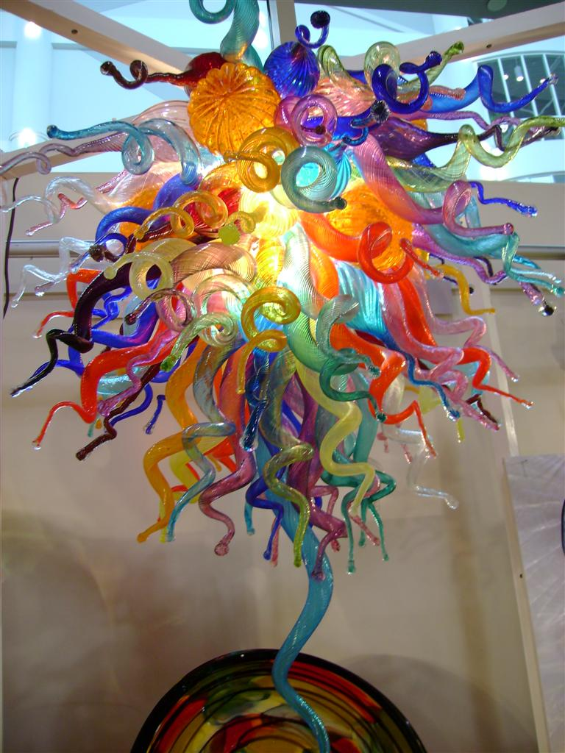
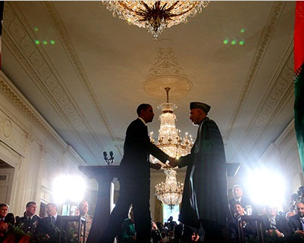
Motivation
[Simon Norfolk, 2010]
[DHC Interiors]
[Dough Mills, 2010]
Notes:
Beautiful luminaires are, as with furniture, more beautiful and interesting when used at special settings. Chandeliers and lamp can be works of art besides serving as light sources.
http://ffxembed.furniturefindex.com/embedshowroom_viewdetail.aspx?pi=721511843&id=1350&pg=2&result=16

Slide 4
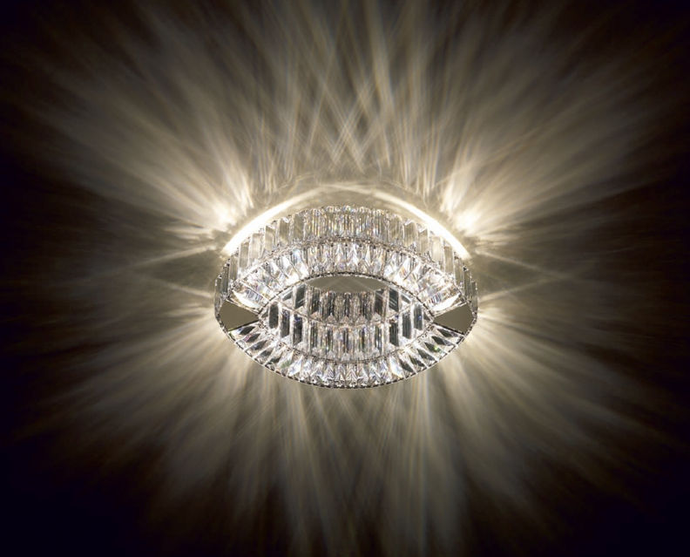
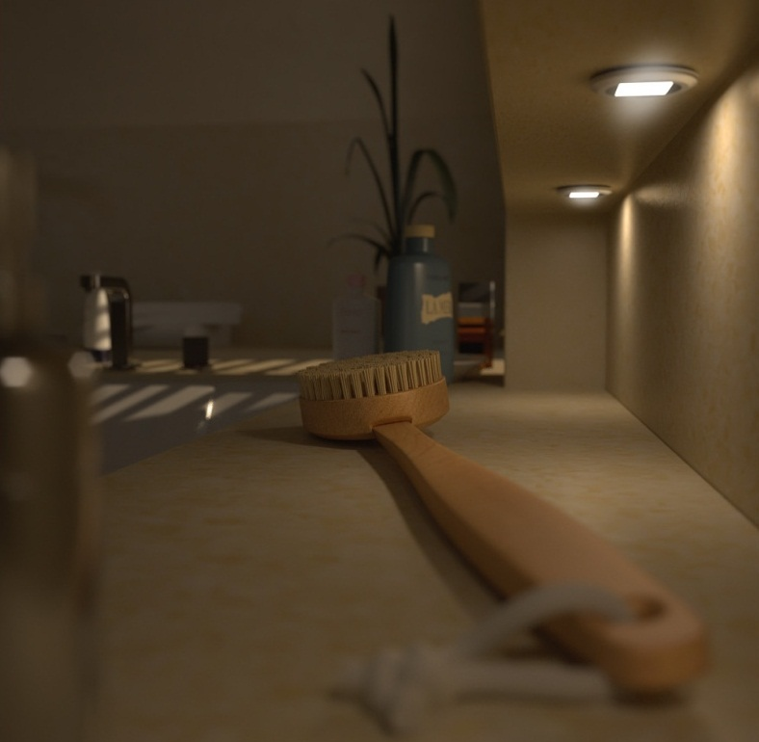
Motivation
Real world luminaires
Computer graphics luminaires
[Swarosvski]
[LuxRender]
Notes:
The CG lamps use an IES data source, but note how the highlights in the wall do not correspond to the size of the luminous aperture.
Besides the shape, the IES representation does not have the nuances and detail of a real source.

Slide 5
Luminaire models in C.G.
Want luminaire and effects on same scene
Takes too long
Replaced with simplified versions

Slide 6
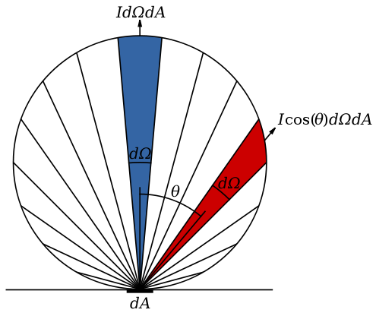
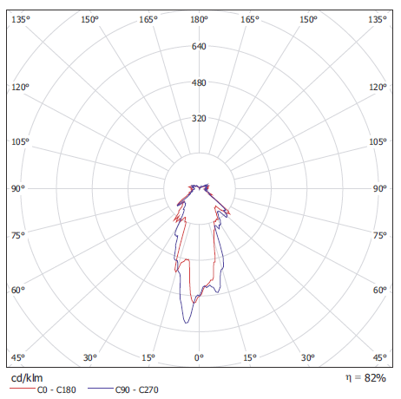
Luminaire models in C.G.
Point based
Omnidirectional
Spotlight
Analytic distribution
Tabulated
Notes:
This should be a different type of illustration: something like a Cornell box, direct light only (or both direct and indirect?) showing the differences between them.

Slide 7
Luminaire models in C.G.
Emissive surfaces
Any infinitesimal patch emits lights following the same distribution (e.g. cosine)
Provide soft shadows, but lack further details
Hacks
“Glow” materials

Slide 8
Our solution
Decoupled from scene
Preprocess once, reuse later
Effects of the luminaire on the scene
Plausible direct view of the luminaire
Notes:
WRONG HEADER!!

Slide 9
Some nomenclature
Near field
Far field

Slide 10
Schedule
Motivation
Previous work
Case study
Method
Results
Future work

Slide 11
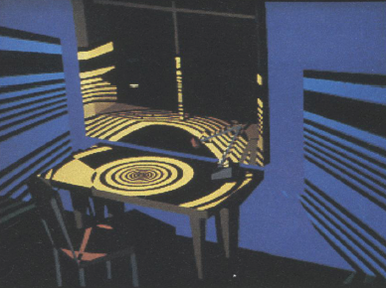
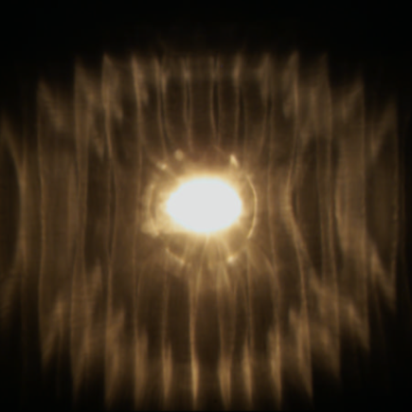
Previous work
Captured luminaire data
Far field
[Verbeck and Greenberg 1984, IESNA 1986,2002]
Near field
[Ashdown 1995, Goesele et al. 2003]

Slide 12
Previous work
Captured luminaire data
Ray sets
[Mas et al. 2008, Mas et a. 2009]

Slide 13
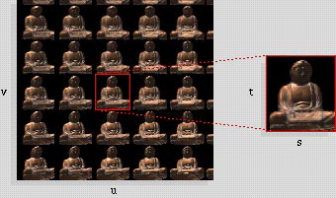
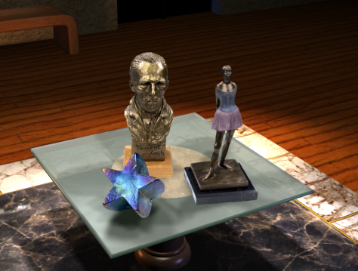
Previous work
Light field representation
Lumigraph
[Gortler et al. 1996; Levoy and Hanrahan 1996; Chang et al. 2003, 2006]
Surface light field
[Wood et al. 2000, Chen et al. 2002]

Slide 14
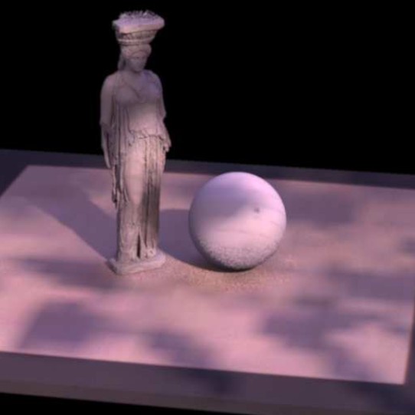
Light field representation
Light sources as light fields
[Heidrich et al. 1998, Unger et al. 2003]

Slide 15
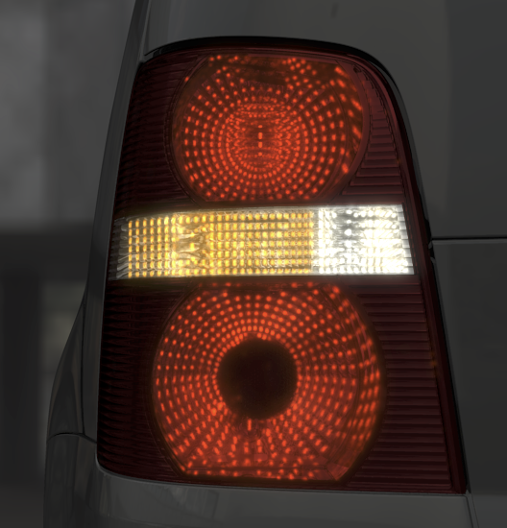
Previous work
Luminaire rendering
Photon mapping-based
[Kniep and Magnor 2009, Hachisuka et al. 2008]

Slide 16
Previous work summary
Limited resolution
Restricted, well defined extent
Aperture
Spatial extent
Either effects on the environment or direct visualization, not both

Slide 17
Schedule
Motivation
Previous work
Case study
Method
Results
Future work

Slide 18
Luminaire rendering
In principle current C.G. techniques allow to simulate complex luminaires
Each component of a luminaire encompasses known phenomena
E.g. reflection, transmission, [subsurface, multiple] scattering, diffraction, refraction

Slide 19
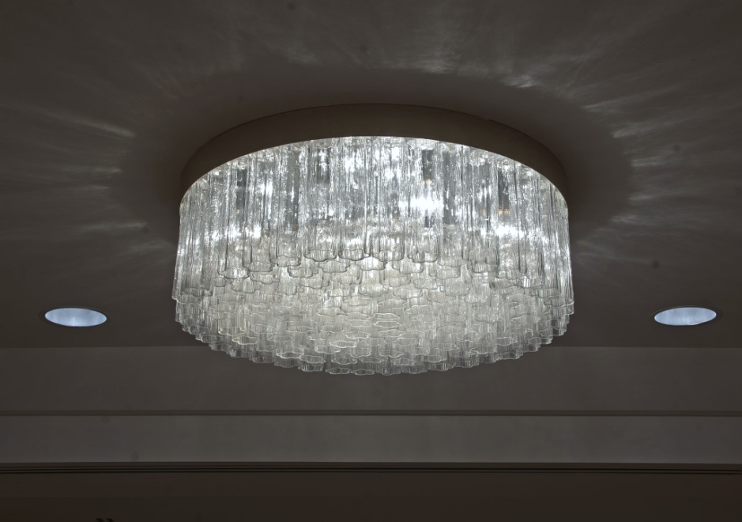
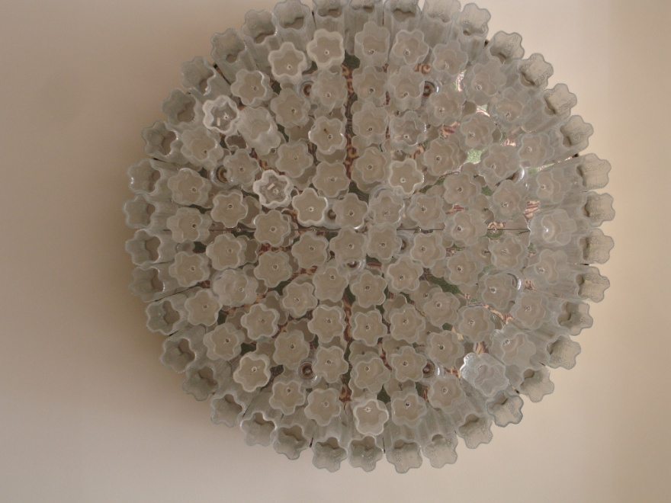
Case study
Luminaire at Statler hotel, Cornell University
12 incandescent bulbs, 117 glass refractors

Slide 20
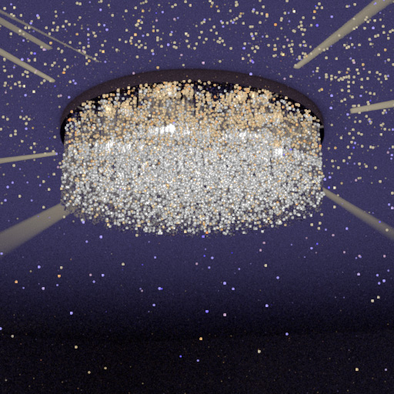
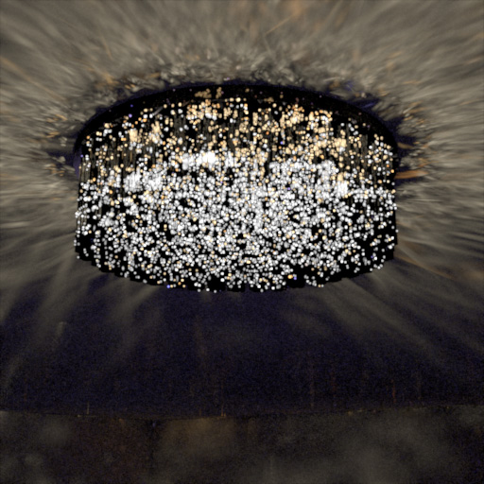
Case study
M.I. Path tracing
Metropolis
1 hour
36 hours
Mutations acceptance rate < 2%
Notes:
The scene is a worst case: L(S|T)+E paths
Timing on laptop 4-core, 8-thread processor (Intel i7-2720QM)

Slide 21
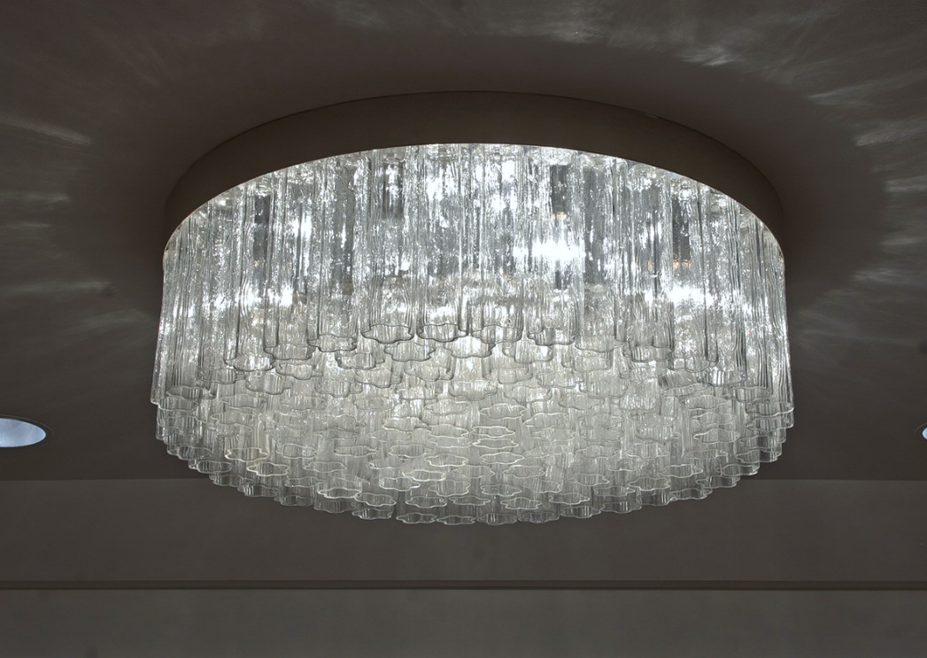
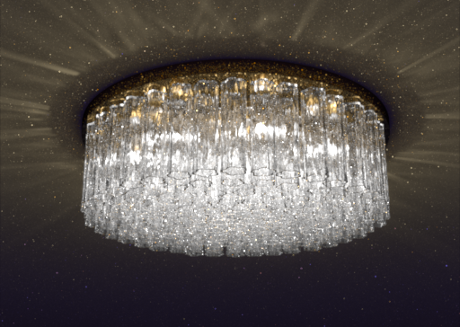
Case study
Photograph
Rendering (bidirectional path tracing)
Rendering time: one CPU core-year

Slide 22
Schedule
Motivation
Previous work
Case study
Method
Results
Future work

Slide 23
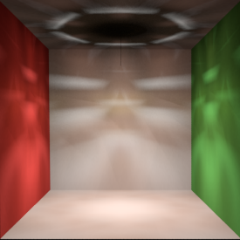
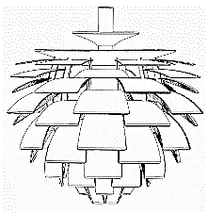
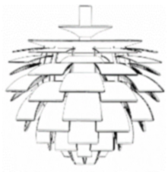
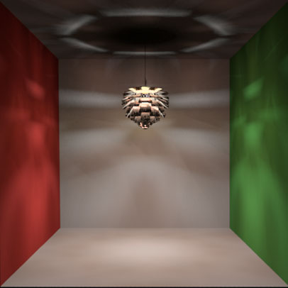
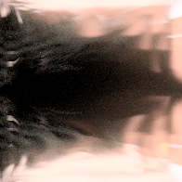

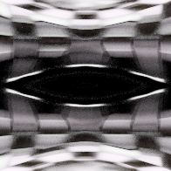

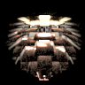
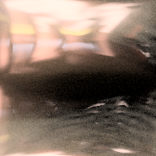
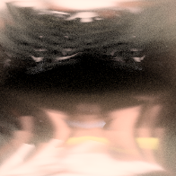
Method
Preprocess
Split Rendering
Effects on the scene
Direct visualization
Once per model

Slide 24
Method
Preprocess
Split Rendering
Effects on the scene
Direct visualization
Once per model

Slide 25
Unsuccessful approaches
'Tis a lesson you should heed:
Try, try, try again.
If at first you don't succeed,
Try, try, try again.
Thomas H. Parker. The Teachers Manual.

Slide 26
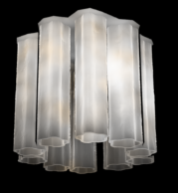
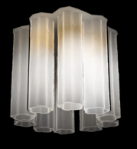
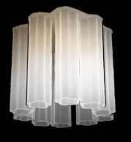
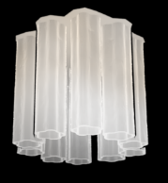
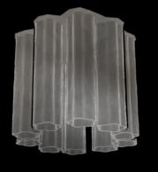
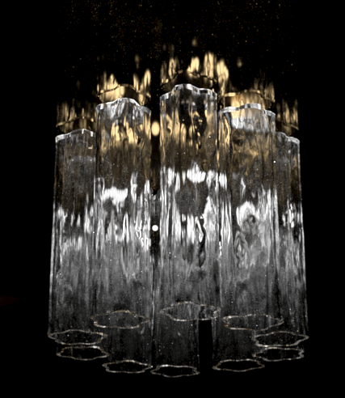
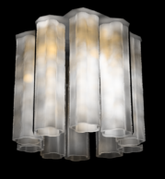




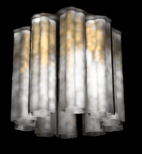
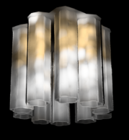



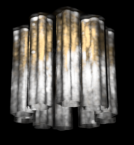
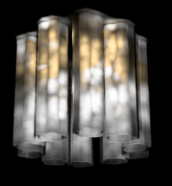
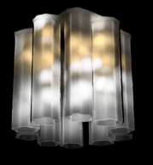



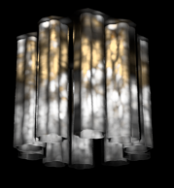



Directional photon mapping
λ = 0.8
λ = 4
λ = 20
λ = 100
λ = 500
1e4 photons
1e5 photons
1e6 photons
1e7 photons
Reference
1e8 photons

Slide 27
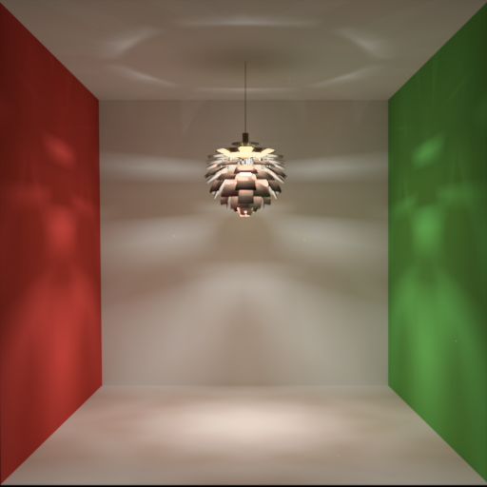
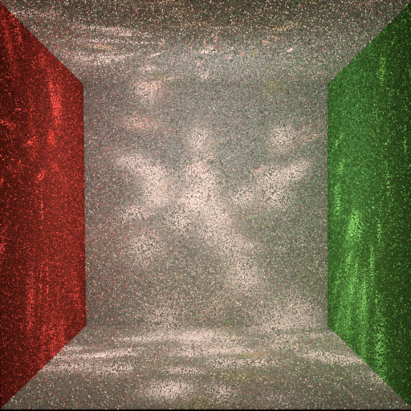
VPLs with arbitrary BRDF
Reference
1,000 glossy VPLs

Slide 28
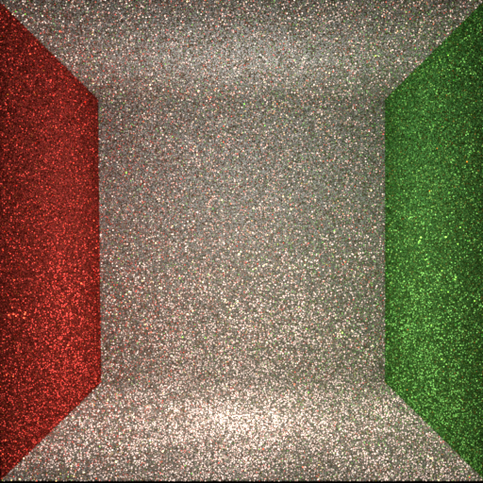
VPLs with arbitrary BRDF
Reference
10,000 glossy VPLs

Slide 29
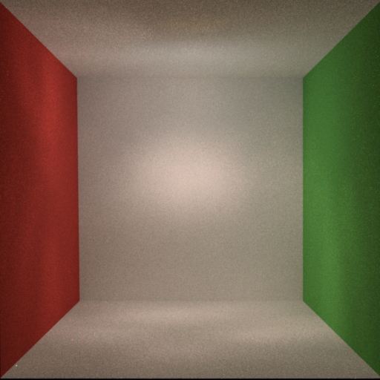
VPLs with arbitrary BRDF
Reference
1,000,000 glossy VPLs

Slide 30
Preprocess
Directionally-varying light sources
100s of millions of outgoing particles
(alias rayset)
Hundreds of point sources

Slide 31
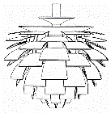
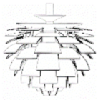
Preprocess
Rayset generation
Trace particles on original luminaire model
Point-sources generation
Choose positions for point-sources
Storage
Store each point-source
Store only last particle before a ray miss
Assign particles to group
Use files at rendering

Slide 32
Point sources generation
How to place the point-sources?
On convex hull (a priori)
Determined by the particles (a posteriori)
Which clustering metric to use?
Position
Position & direction
Great-circle distance
Ray-line projection

Slide 33
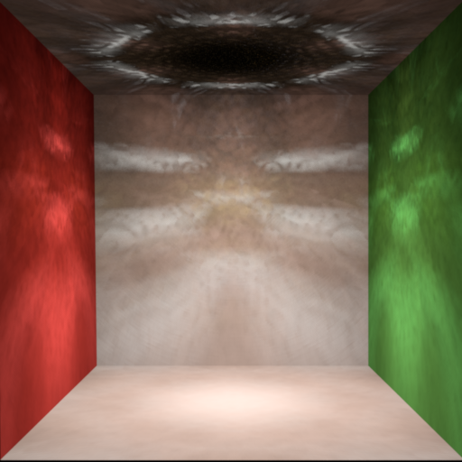
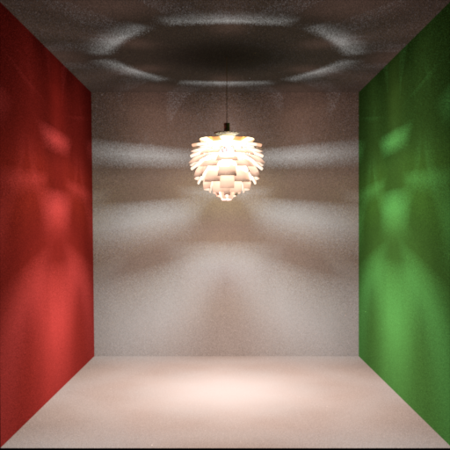
Point sources placement
Convex hull + ray-line
Reference

Slide 34

Point sources placement
Convex hull + great circle
Reference

Slide 35

Point sources placement
K-means + position & direction
Reference
Notes:
Look better, but the patterns are seriously displaced

Slide 36

Point sources generation
Positions
Agglomerative clustering [Walter et al. 2008]
Cluster
Squared distance to centroids only
Project
Concentric circle mapping
Point sources at each cluster’s centroid
Position and power of subset of particles

Slide 37
Method
Preprocess
Split Rendering
Effects on the scene
Direct visualization
Once per model

Slide 38
Method
Preprocess
Split Rendering
Effects on the scene
Direct visualization
Once per model

Slide 39
Method
Preprocess
Split Rendering
Effects on the scene
Direct visualization
Once per model

Slide 40
Direct visualization
Aim for perceptually-plausible result
Separate components
Geometry: edges and salient features
High-intensity patterns

Slide 41



Multi-pass approach
Render parts separately, then combine
High frequency “sparkles”
Detailed geometry
Composite image

Slide 42








Limited number of bounces
2 bounces
3 bounces
4 bounces
5 bounces
6 bounces
7 bounces
30 bounces
Reference
Notes:
4Ki samples per pixel

Slide 43
Schedule
Motivation
Previous work
Case study
Method
Results
Future work

Slide 44
Results
Direct illumination
512 point lights,
512x512 bitmaps, 1 billion particles
Complex luminaires in Cornell Box
Focus on the lighting effects
Shadows
Data reuse

Slide 45
Models
Troffer
P.H. Artichoke
Statler
Met “Sputnik”
V&A Chandelier

Slide 46



Troffer
Ours – 512 clusters
Reference
37 s
8,720 s

Slide 47


Troffer - isocontours
Ours – 512 clusters
Reference

Slide 48



P.H. Artichoke
Ours – 512 clusters
Reference
36 s
8,438 s

Slide 49


P.H. Artichoke - isocontours
Ours – 512 clusters
Reference

Slide 50



Statler
Ours – 512 clusters
Reference
39 s
1,227,560 s

Slide 51


Statler - isocontours
Ours – 512 clusters
Reference

Slide 52



Met “Sputnik”
Ours – 512 clusters
Reference
48 s
13,100 s

Slide 53


Met “Sputnik” - isocontours
Ours – 512 clusters
Reference

Slide 54



V&A Chandelier
Ours – 512 clusters
Reference
40 s
22,360 s

Slide 55


V&A Chandelier - isocontours
Ours – 512 clusters
Reference

Slide 56






Troffer shadows
Reference

Slide 57





Troffer shadows
Ideal area source

Slide 58





Troffer shadows
Only position

Slide 59





Troffer shadows
Position & power agglomerative

Slide 60
Troffer shadows
Reference

Slide 61
Direct Visualization
Direct illumination plus separately-rendered images

Slide 62


Troffer
Ours
Reference
131 s
8,720 s

Slide 63


Artichoke
Ours
Reference
125 s
8,438 s

Slide 64


Met “Sputnik”
Ours
Reference
173 s
13,100 s

Slide 65


Statler
Ours
Reference
446 s
1,227,560 s

Slide 66


V&A Chandelier
Ours
Reference
179 s
22,360 s

Slide 67
Reusing the data
230 min
1920x1080, 1280 point sources, 16x AA
Notes:
35 min - sparkles
10 min – geometry image
185 min – direct lighting

Slide 68
Schedule
Motivation
Previous work
Case study
Method
Results
Future work

Slide 69
Future work
Glow due to multiple scattering
Volumetric radiance field
Basis projection
Gaussian fitting
…

Slide 70
Future work
Compression
PCA, wavelets, quantized vector dictionary, …
Performance
Memory bound
System integration
Tradeoff quality/cost
How to determine it

Slide 71
Acknowledgements
Wenzel Jakob
Adrianne Ngam, Gretchen Craig, Sonny Xu
Autodesk 360 RaaS team

Slide 72
Complex Luminaire Rendering
Edgar Velázquez-Armendáriz | Zhao Dong | Bruce Walter | Donald P. Greenberg
Program of Computer Graphics, Cornell University
February 25th 2013

Slide 73
Slide Graveyard
Postlude

Slide 74


Motivation
Real world luminaires
Computer graphics luminaires

Slide 75

Motivation
Cultural heritage
[Gutiérrez et al. 2008, Gonçalves et al. 2009]
[Delvin and Chalmers 2001, Delvin et al. 2002]
Notes:
Duccio di Buoninsegna, The Annunciation (tempera, ca 1308) National Gallery London
Pompeii fresco

Slide 76


Slide 77
Previous work summary
Luminaire rendering explored disjoint from illumination due to luminaires
Image-based light field representations
Good detail and high compression
Non-scalable approaches
Full detail always

